Slide 1




University Institute of Engineering
Department of Computer Science & Engineering
COMPUTER ORGANIZATION & ARCHITECTURE
(23CST-204/23ITT-204)
ER. SHIKHA ATWAL
E11186
ASSISTANT PROFESSOR
BE-CSE

Slide 2
TILED CHIP MULTICORE PROCESSORS
Tiled chip multicore processors are processors that consist of multiple smaller cores, or tiles, on a single chip. These cores can work independently and in parallel to perform multiple tasks at the same time, increasing the overall performance and efficiency of the processor. Tiled chip multicore processors are often used in high-performance computing applications, such as servers and supercomputers, as well as in mobile devices and other consumer electronics.
Tiled chip multicore processors, also known as many-core processors, are processors that have multiple cores integrated onto a single chip. These cores are arranged in a grid-like structure, or "tile," which allows for efficient communication and data transfer between the cores. The number of cores can range from a few to hundreds, depending on the specific design of the processor.

Slide 3
Each core in a tiled chip multicore processor is capable of executing its own instruction stream, allowing for parallel processing of multiple tasks. This can greatly improve performance and power efficiency, as it allows multiple tasks to be executed simultaneously, rather than sequentially. This is particularly beneficial for high-performance computing applications, such as servers, supercomputers, and high-end gaming systems, where multiple tasks are executed simultaneously.
In a tiled chip multicore processor, the cores are connected to each other through a high-speed interconnect, which allows them to share data and communicate with each other. This interconnect can take the form of a bus, a crossbar, or a network-on-chip (NoC) architecture. The choice of interconnect will depend on the specific design of the processor and the requirements of the application for which it is intended.

Slide 4
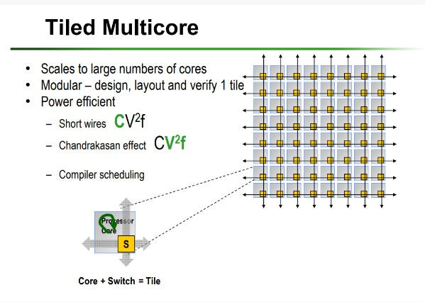

Slide 5
Tiled chip multicore processors also typically include a shared cache, which is a small amount of memory that is shared by all of the cores. This allows the cores to quickly access data that is frequently used, reducing the need for them to access main memory, which can be much slower. This can also help to improve power efficiency, as accessing main memory requires more power than accessing the shared cache.
In addition to high-performance computing applications, tiled chip multicore processors are also used in mobile devices and embedded systems. In these applications, the multiple cores can be used to improve performance and power efficiency while also allowing for the execution of multiple tasks simultaneously.

Slide 6
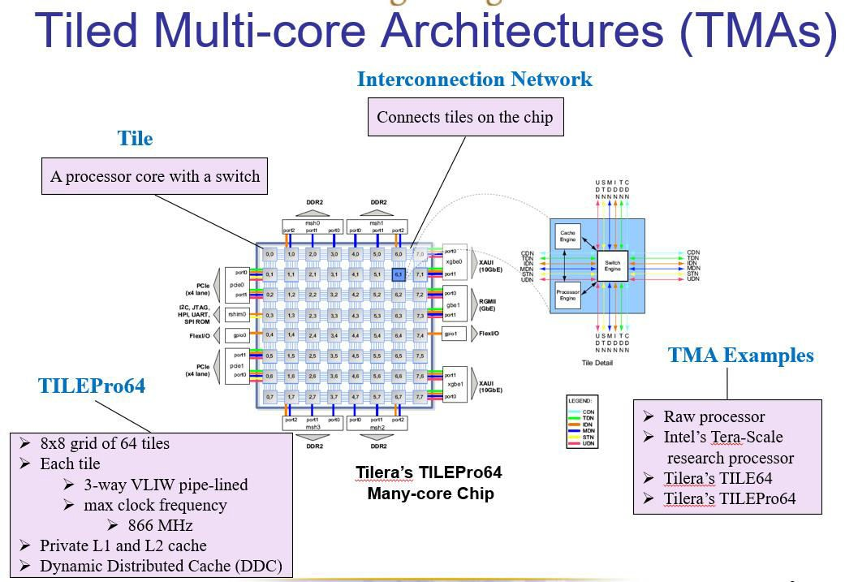

Slide 7
Overall, Tiled chip multicore processors are designed to improve performance and power efficiency by allowing multiple tasks to be executed simultaneously. They have been widely adopted in high-performance computing applications, as well as in mobile devices and embedded systems. The number of cores and the choice of interconnect will depend on the specific design of the processor and the requirements of the application for which it is intended.

Slide 8
References
Reference Books:
J.P. Hayes, “Computer Architecture and Organization”, Third Edition.
Mano, M., “Computer System Architecture”, Third Edition, Prentice Hall.
Stallings, W., “Computer Organization and Architecture”, Eighth Edition, Pearson Education.
Text Books:
Carpinelli J.D,” Computer systems organization &Architecture”, Fourth Edition, Addison Wesley.
Patterson and Hennessy, “Computer Architecture”, Fifth Edition Morgaon Kauffman.

Slide 9
Other References:
https://ui.adsabs.harvard.edu/abs/2009tms..book....1T/abstract
http://libgen.rs/book/index.php?md5=867AD43FA22BD6037765B37F9C98828C
Video Links:
https://youtu.be/AxJyGpuXypY?si=KICYxAWFtjgvshPw
https://youtu.be/BMzUQvd8qKU?si=DQrpCW1lPsH_Pd0B

